Slide 1
EDA ON CREDIT RISK ANALYSIS
BY
SHAIL SHAH

Slide 2
WHAT IS CREDIT RISK
Credit risk is the credit risk or potential loss that may occur due to failure of borrower/ counterparty to meet the obligation on agreed terms and conditions of financial contract
AIM OF THE CASE STUDY
This case study aims to identify patterns which indicate if a client has difficulty paying their
installments which may be used for taking actions such as denying the loan, reducing the amount
of loan, lending (to risky applicants) at a higher interest rate, etc.

Slide 3
WE HAVE USED TWO DATASET
1)Application_data.csv
2)Previous_data.csv
STEPS FOR EDA
Data sourcing
Data cleaning
Data pr-processing
4) Data Visualiszation
5) Conclusion

Slide 4
Data collection is the process of gathering information in an established systematic way that enables one to test hypothesis and evaluate outcomes easily.
Data cleaning is the process of ensuring that your data is correct and useable by identifying any errors in the data, or missing data by correcting or deleting them.
Data pre-processing is a data mining technique that involves transforming raw data into an understandable format. It includes normalisation and standardisation, transformation, feature extraction and selection, etc. The product of data pre-processing is the final training dataset.
Data visualisation is the graphical representation of information and data. It uses statistical graphics, plots, information graphics and other tools to communicate information clearly and efficiently.

Slide 5
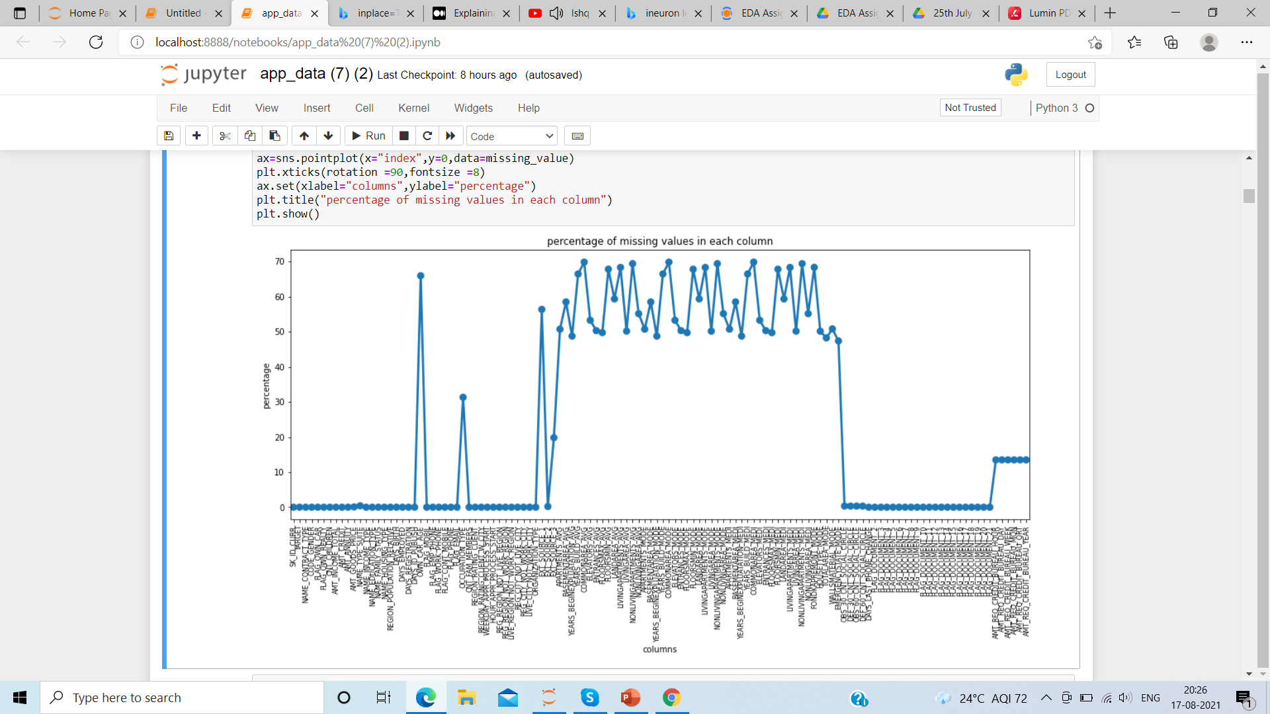
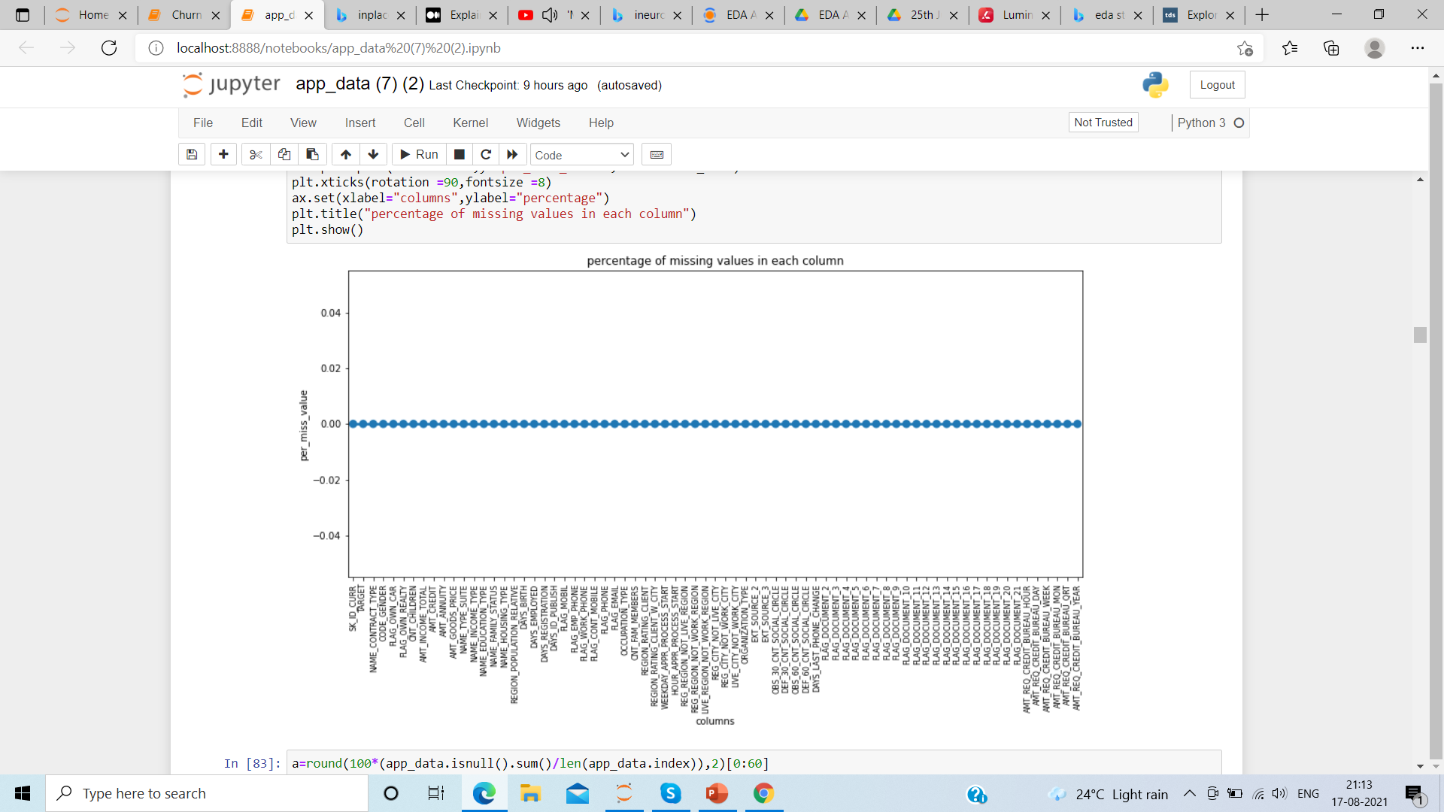
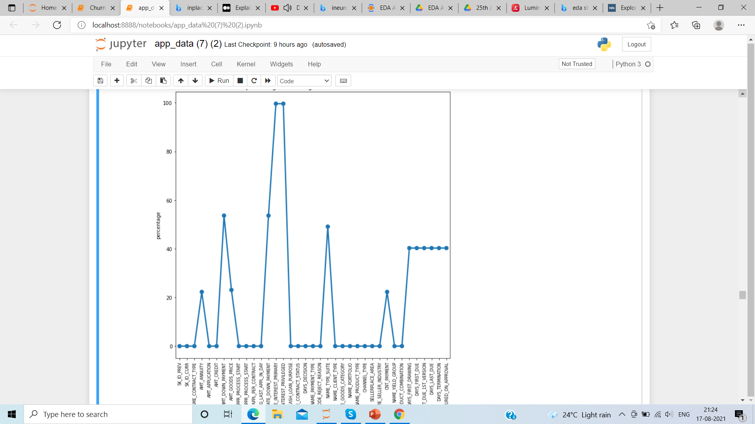
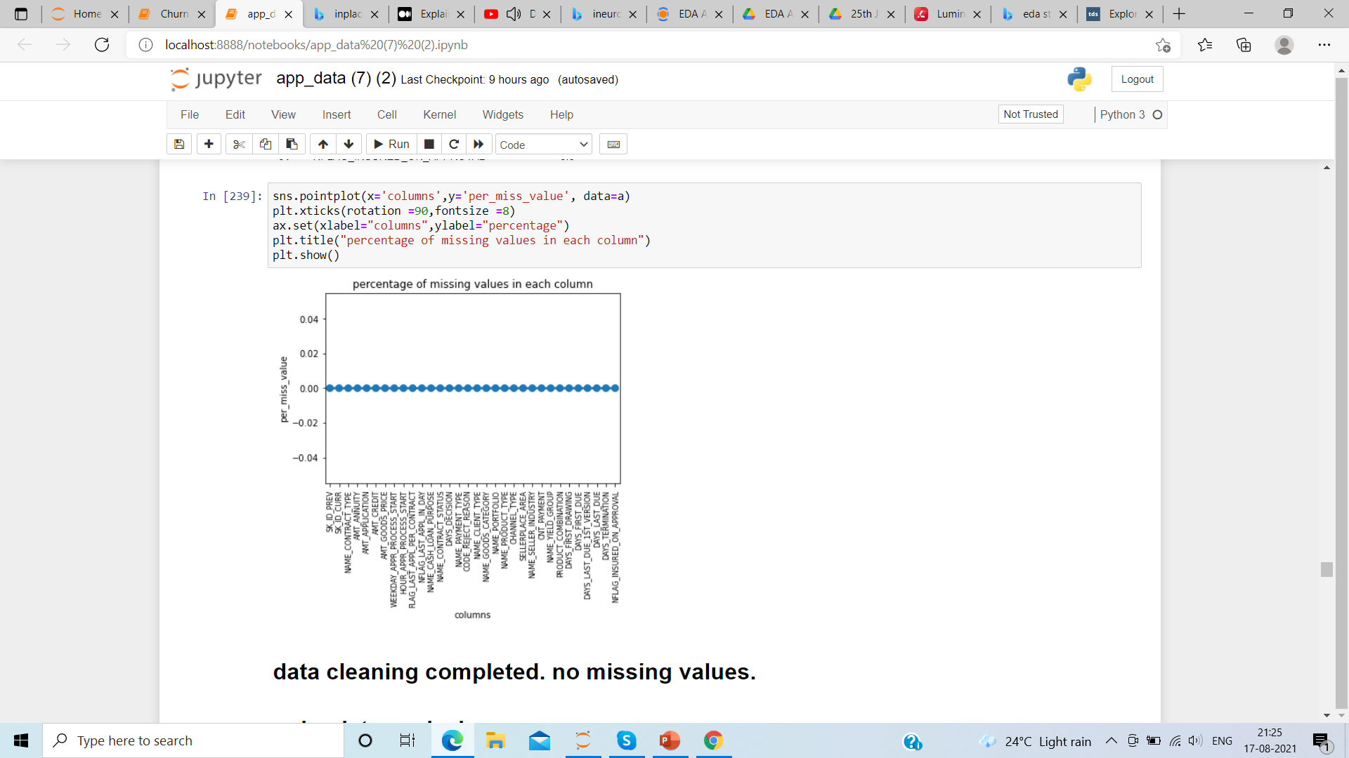
From application dataset
Before cleaning dataset having null values
After cleaning
From previous dataset

Slide 6
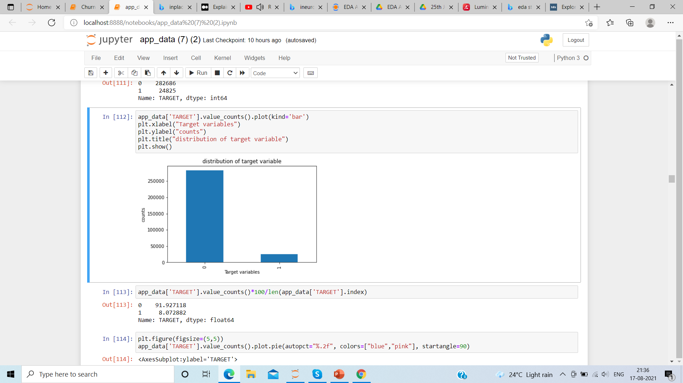
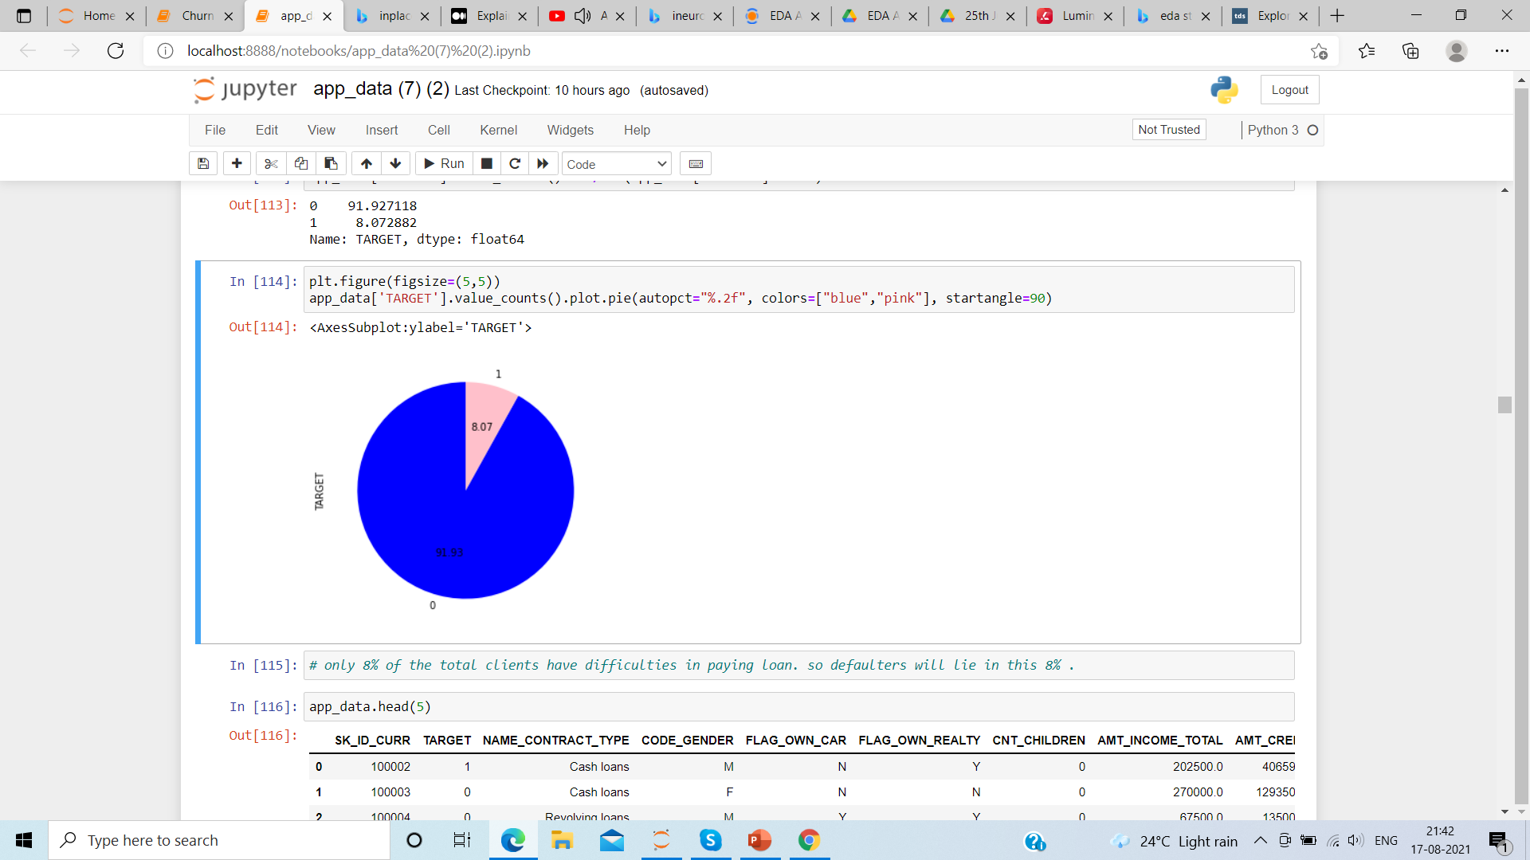
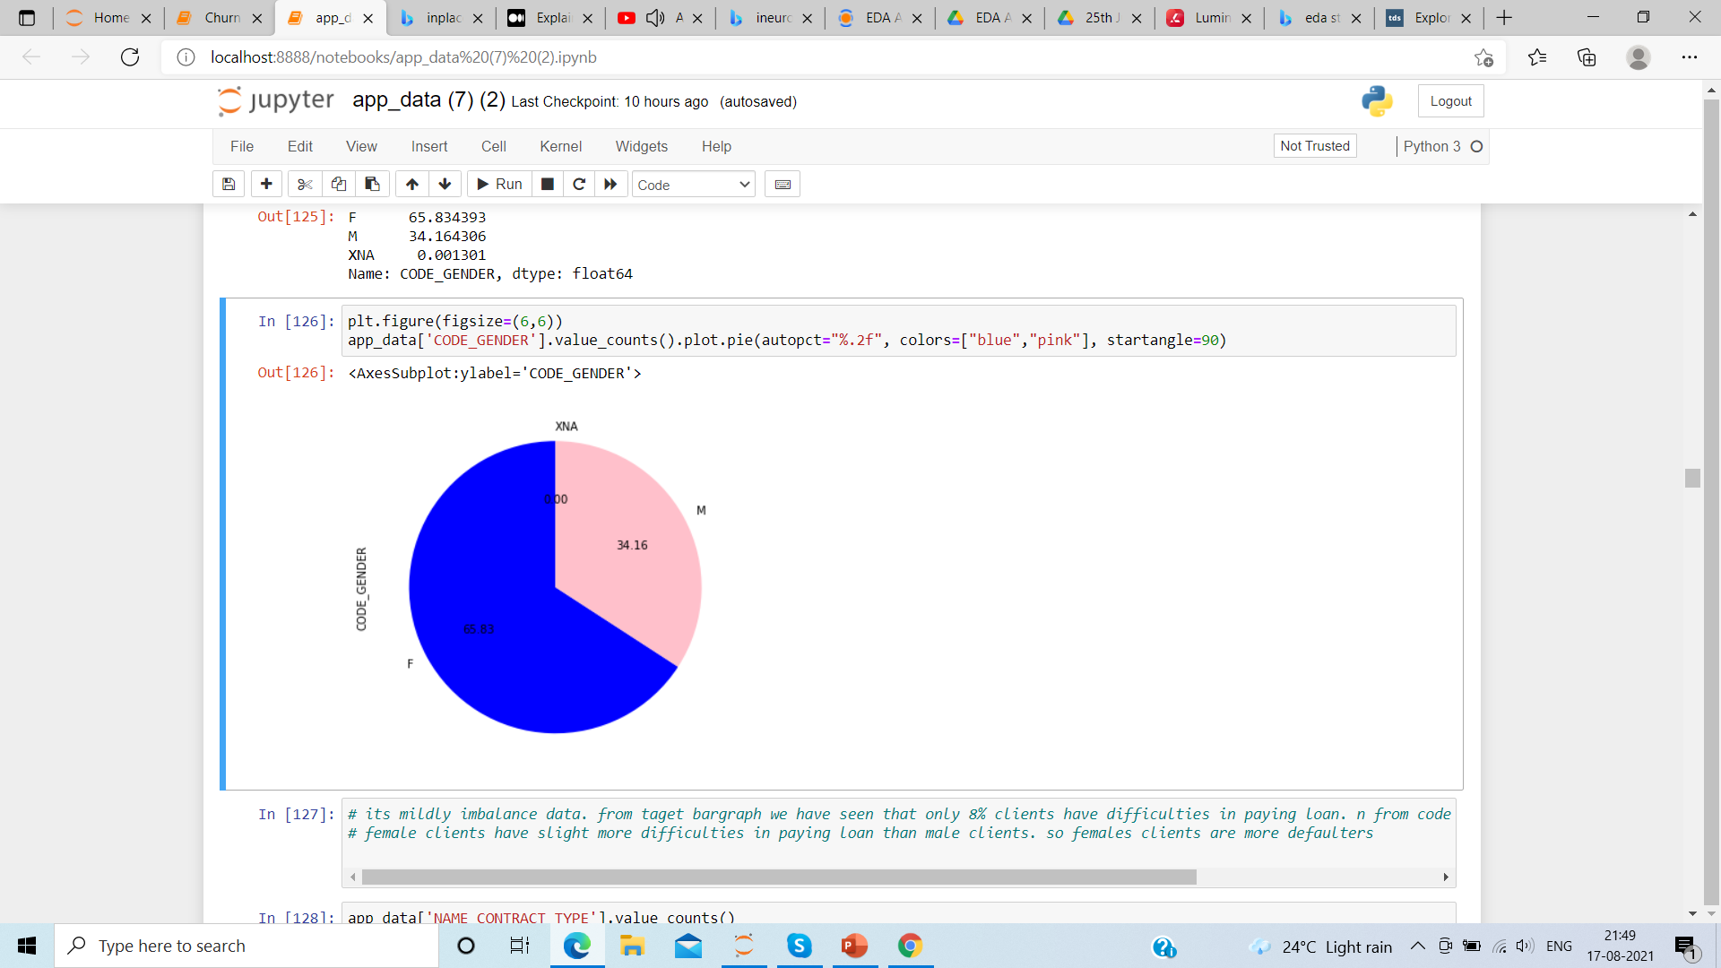
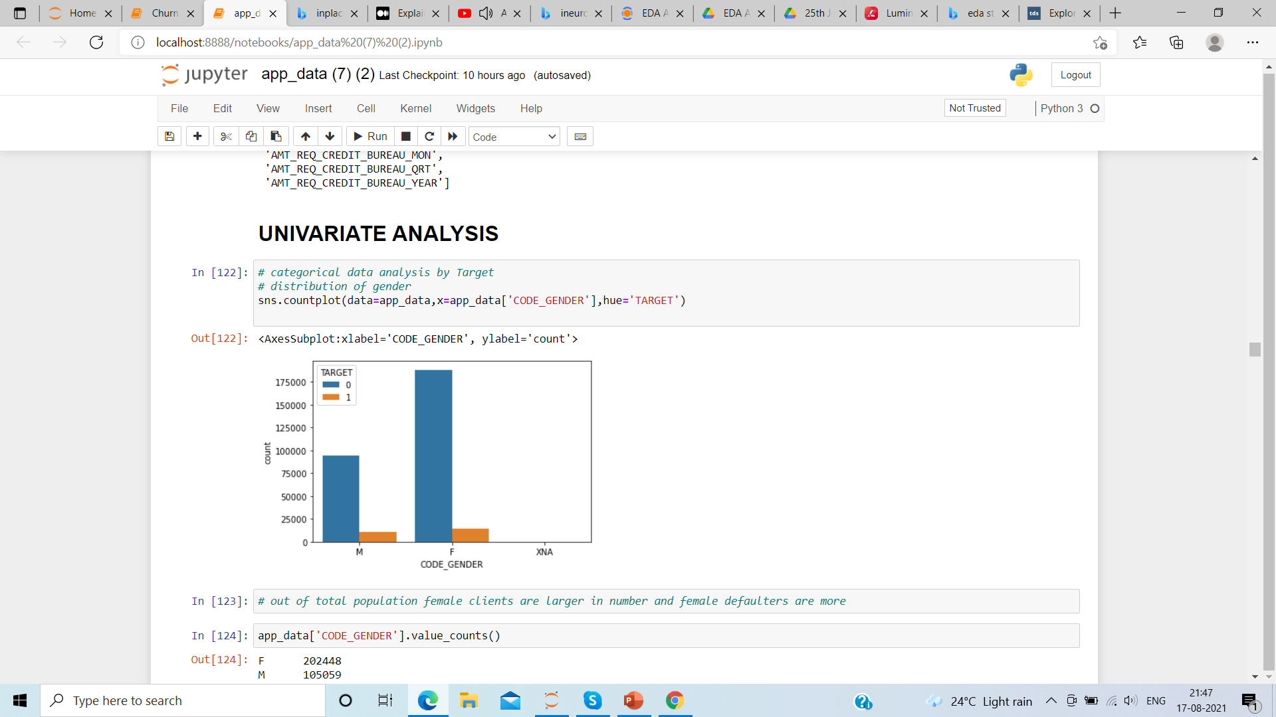
Data exploration and visualization
Target variables are variables which shows the defaulters, out of the total clients who has applied for loans , 8% are likely to fail to repay the loan
65% of the clients are female and they have more difficulties in paying loan comparison to male clients.

Slide 7
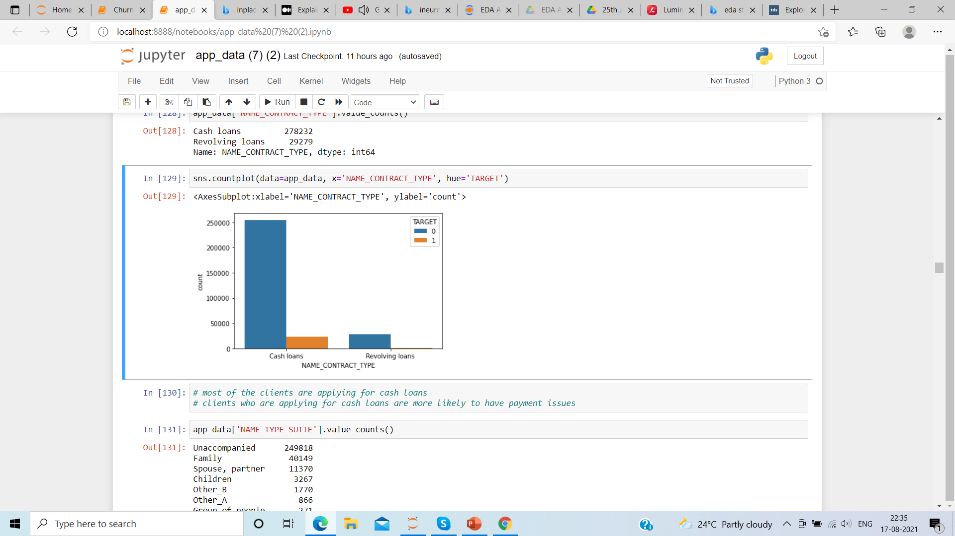
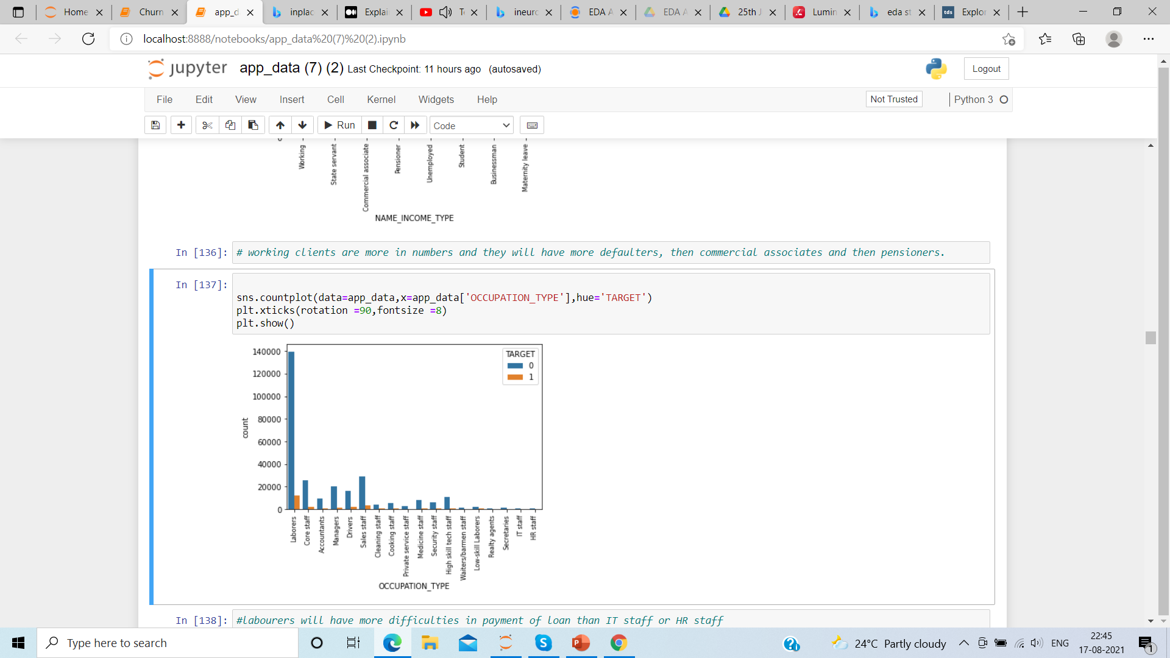
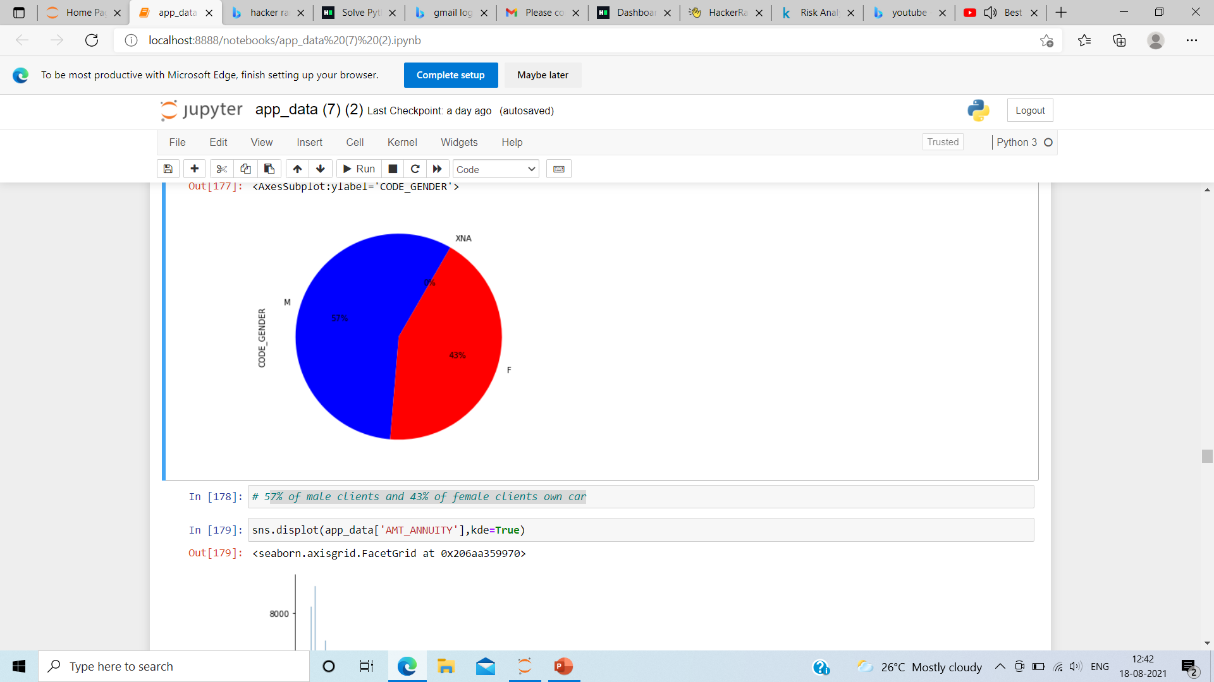
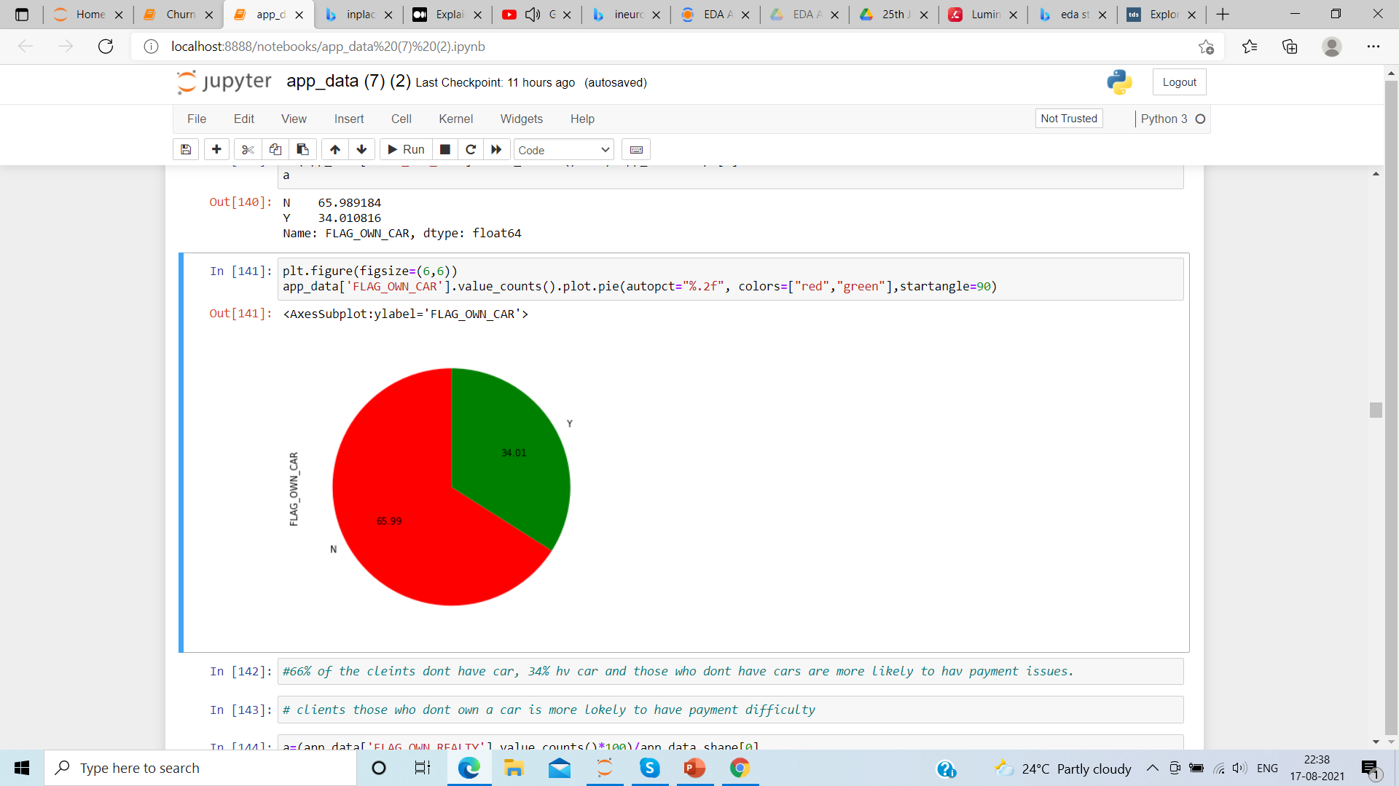
Most of the clients applied for cash loan and among those clients are the defaulters
Most of the clients are laborer and they have payment difficulty than IT or HR staff
57% of male clients and 43% of female clients own car
66% of the clients don’t have car

Slide 8
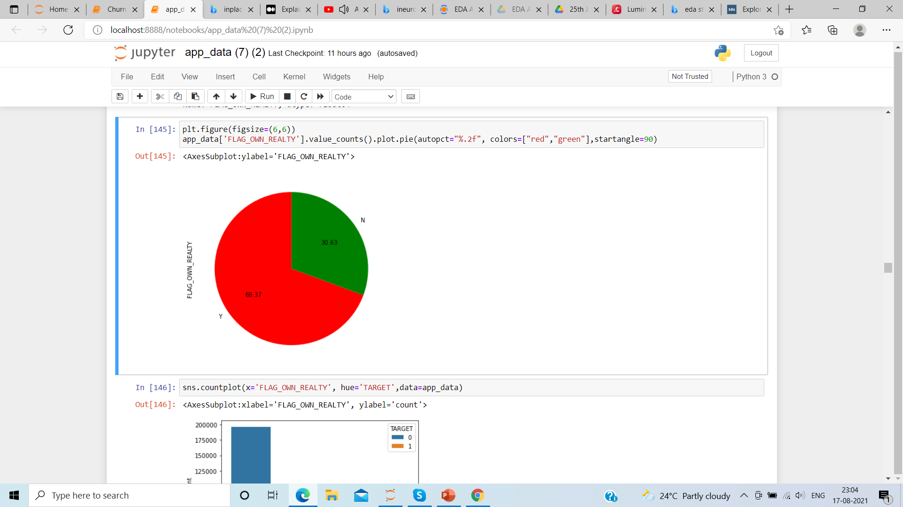
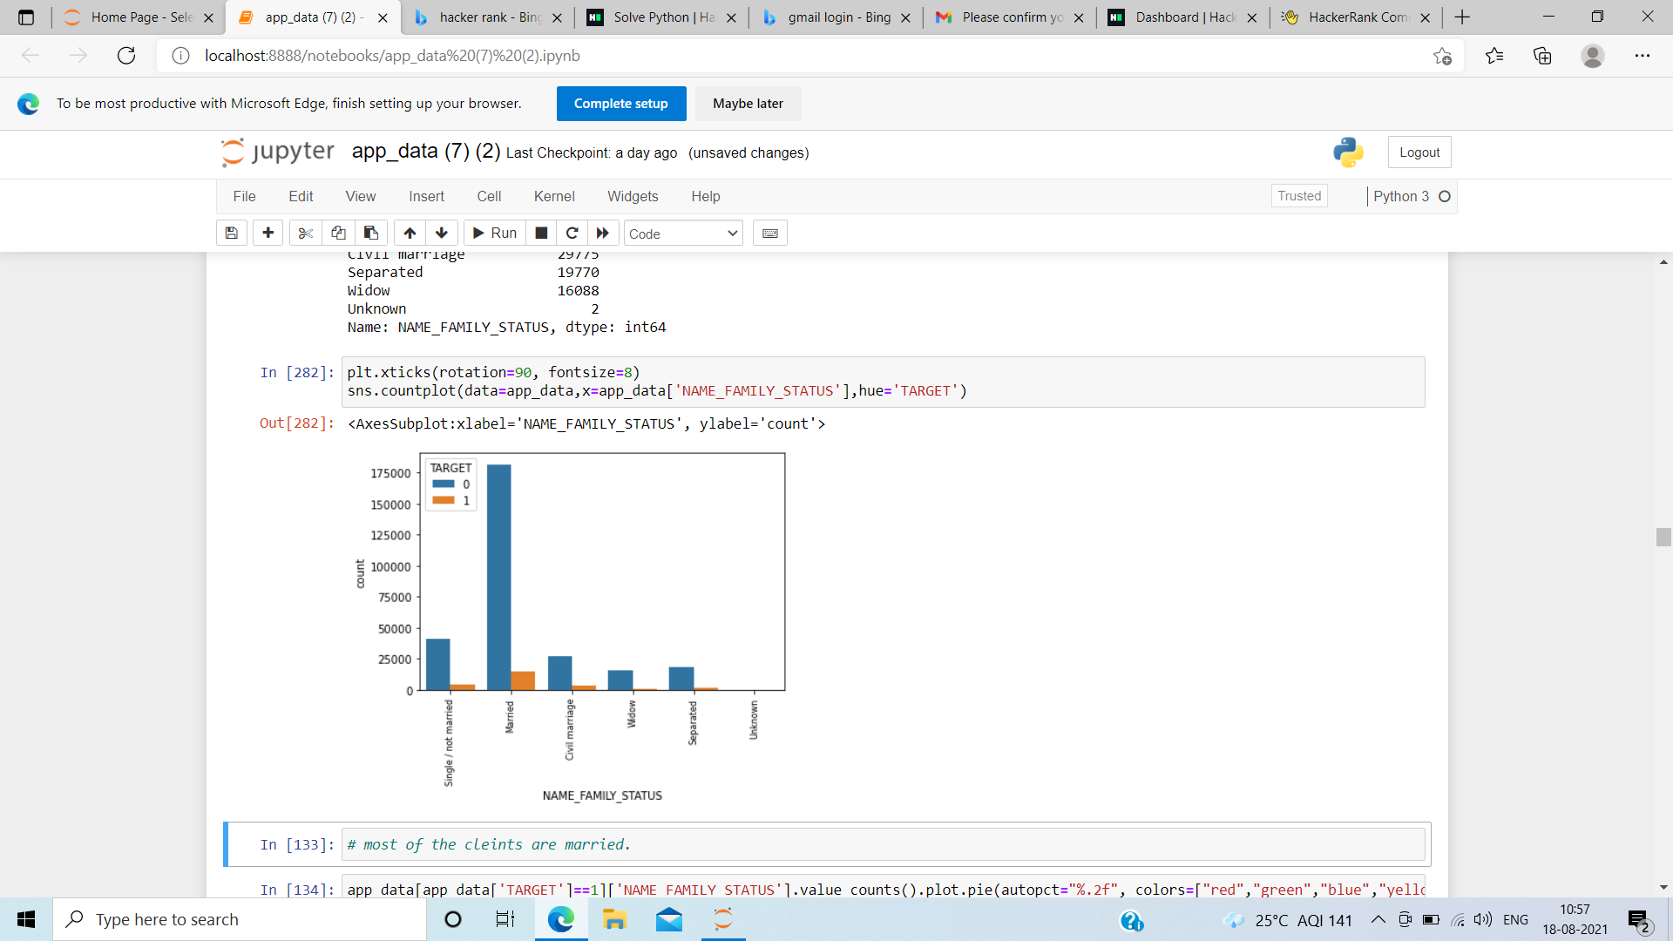
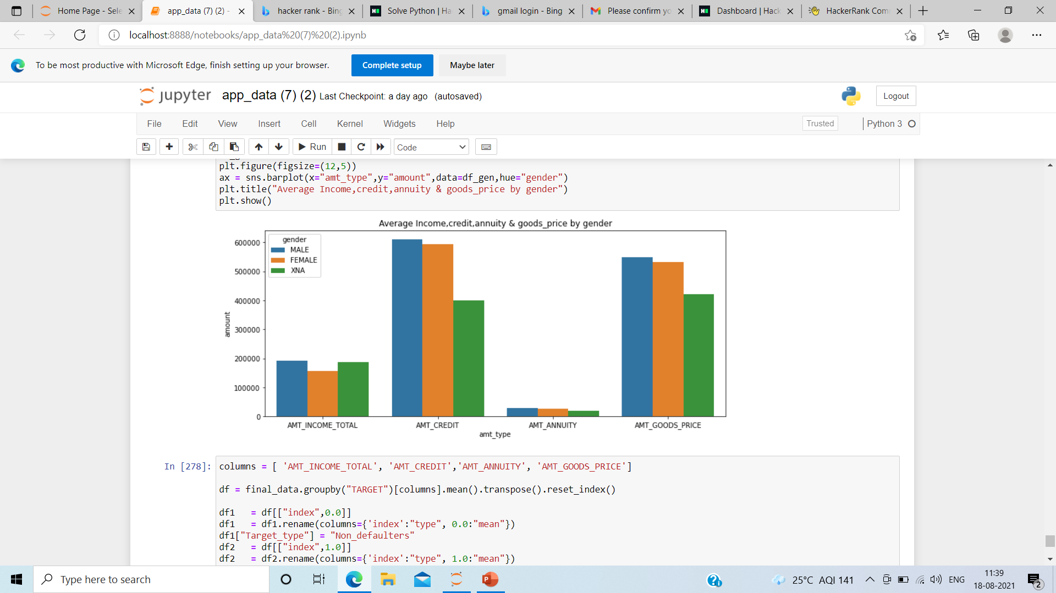
69% of the clients have their property
Most of the clients are married and most of defaulters are among them
average income and amount annuity paid is same for both male and female.

Slide 9
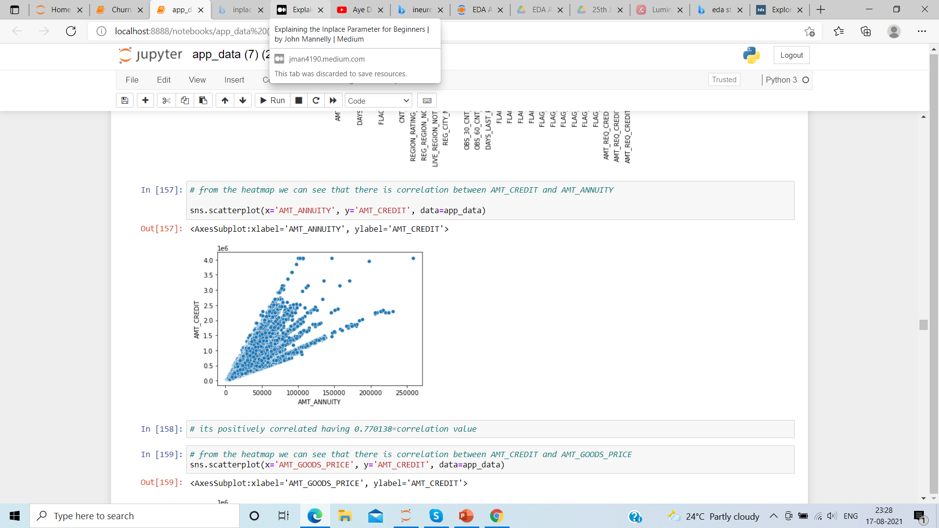
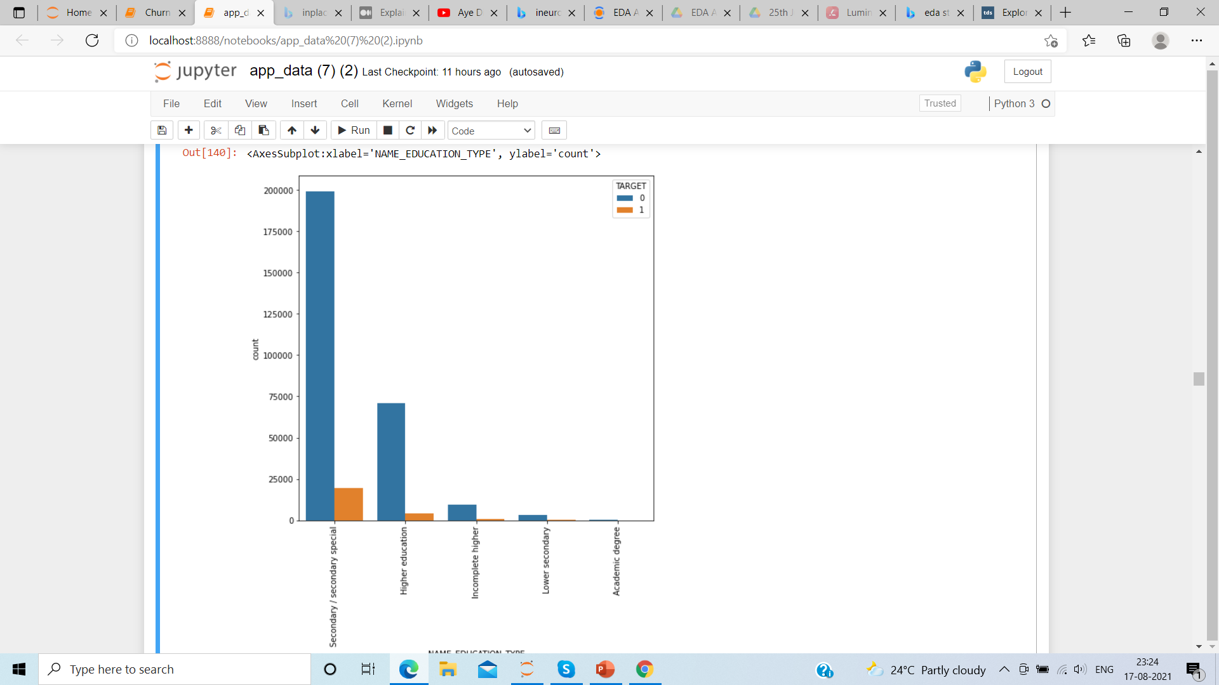
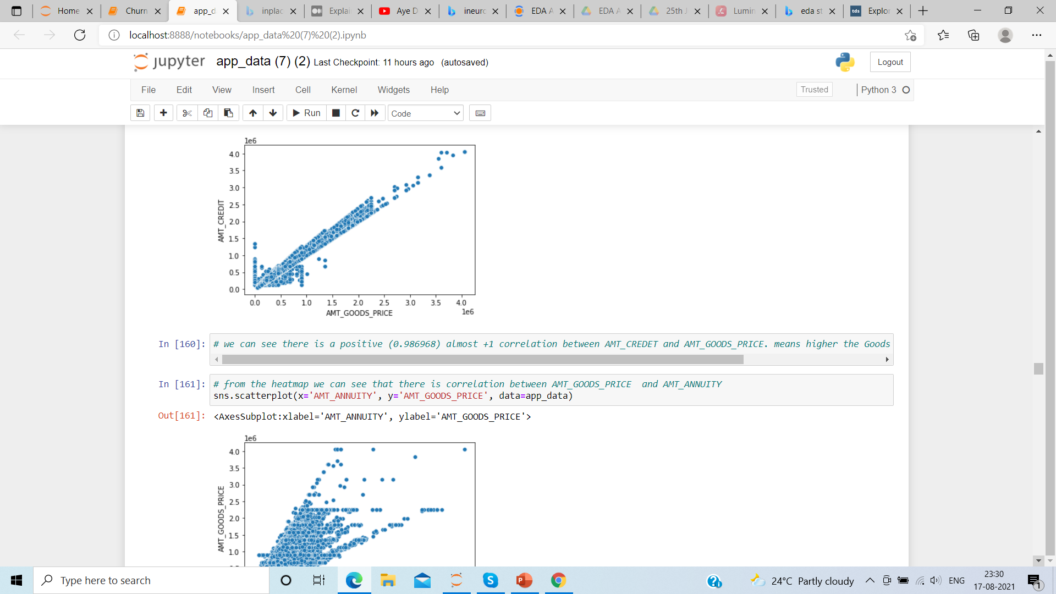
Its positively correlated. Higher the loan amount loan, higher will be the annuity
most of the clients with less than higher education are defaulters
Its positively correlated with 0.9 correlation. Higher the price of goods, higher the loan amount respectively

Slide 10
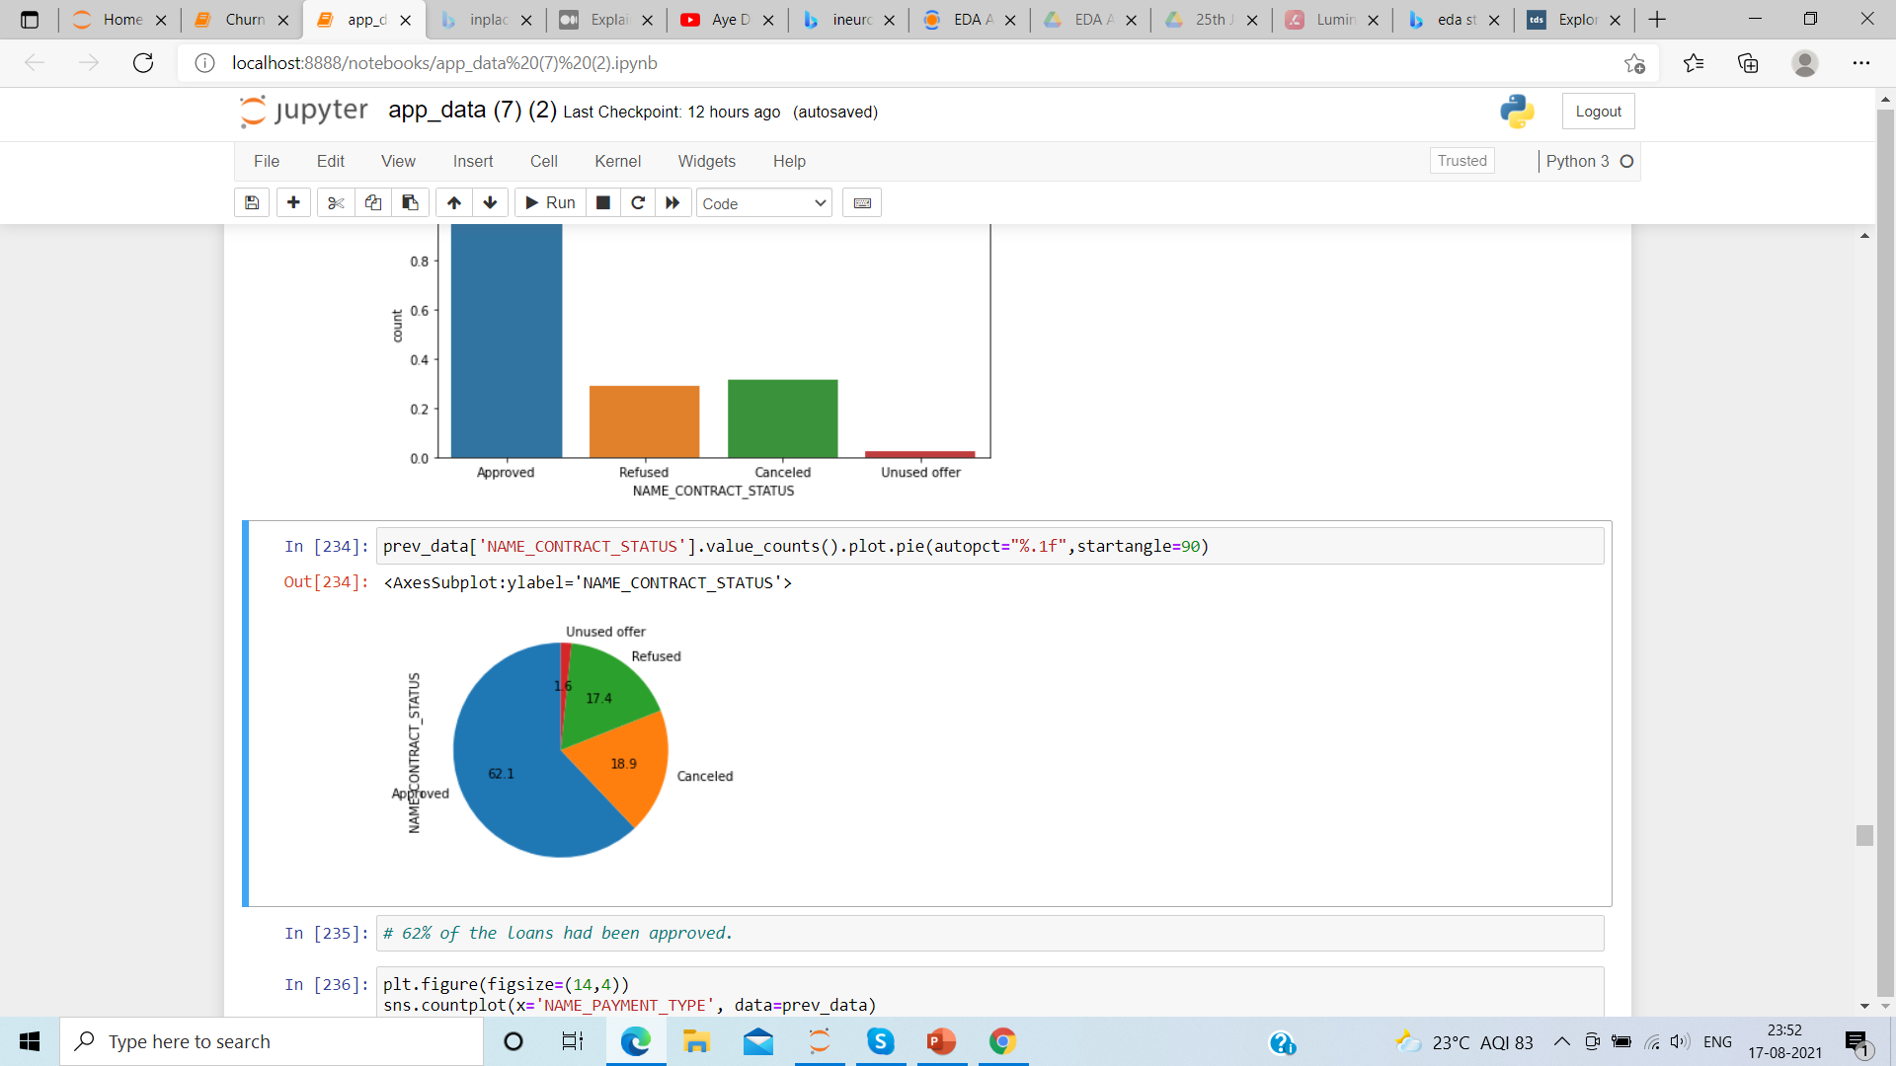
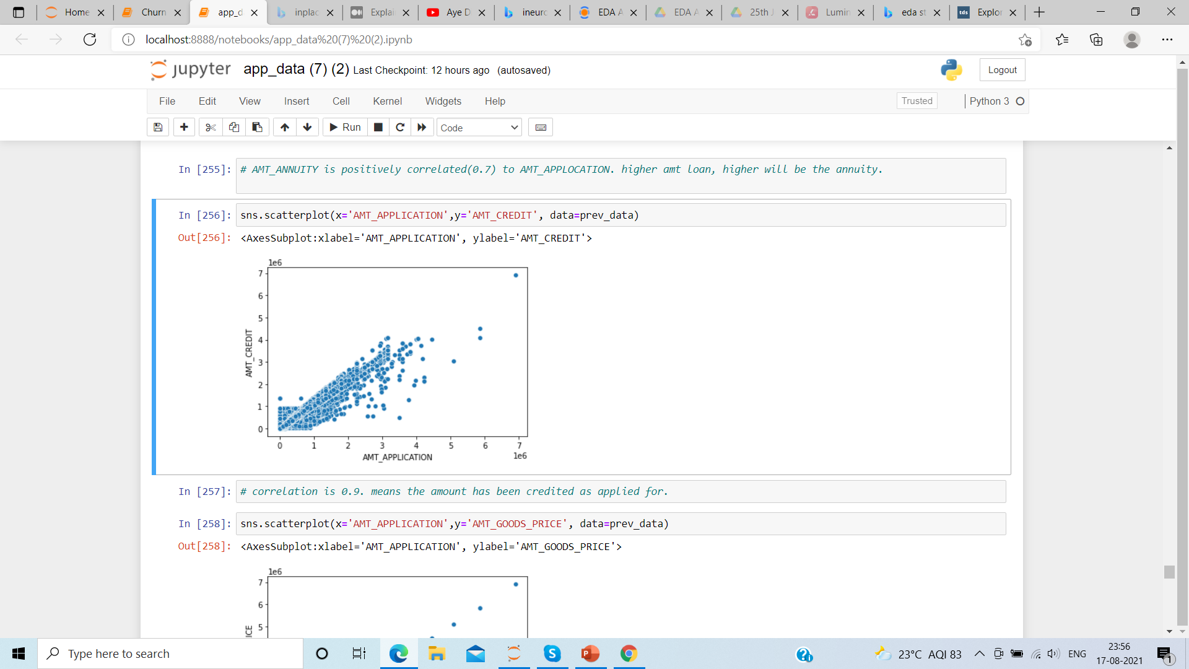
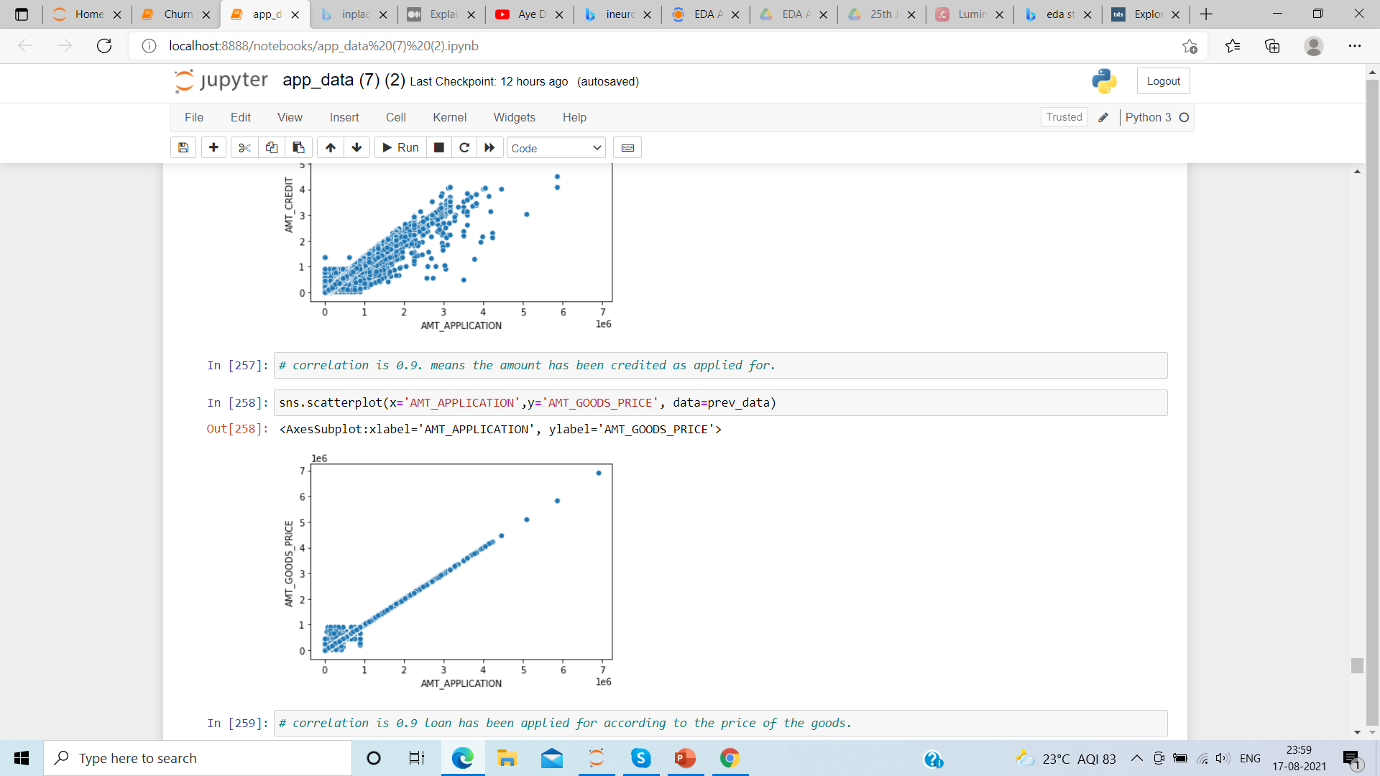
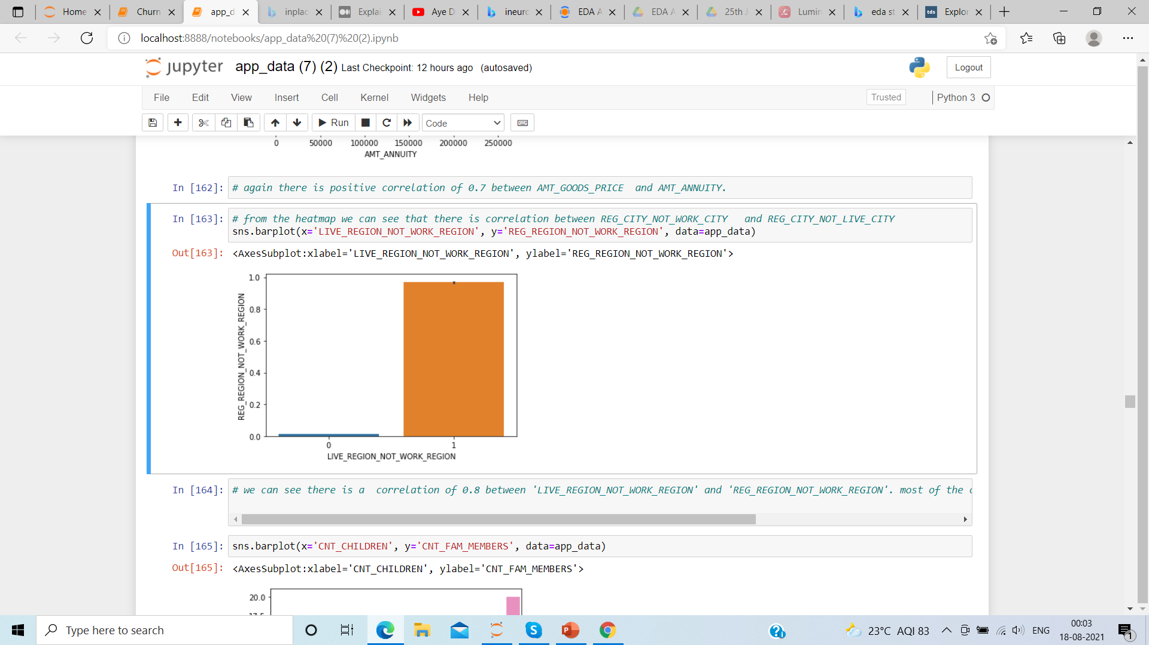
62% of the loan has been approved
correlation is 0.9. means the amount has been credited as applied for.
positive correlation.
most of the client’s permanent address differs from work address

Slide 11
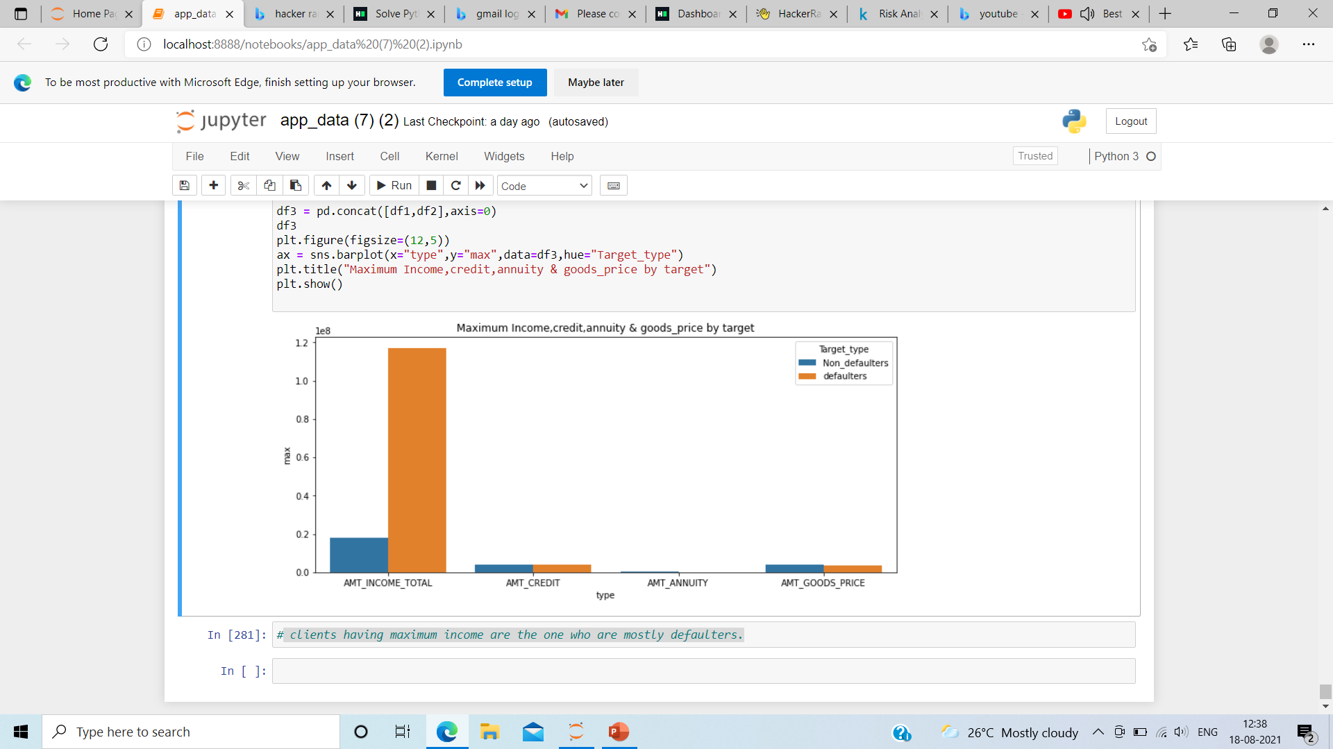
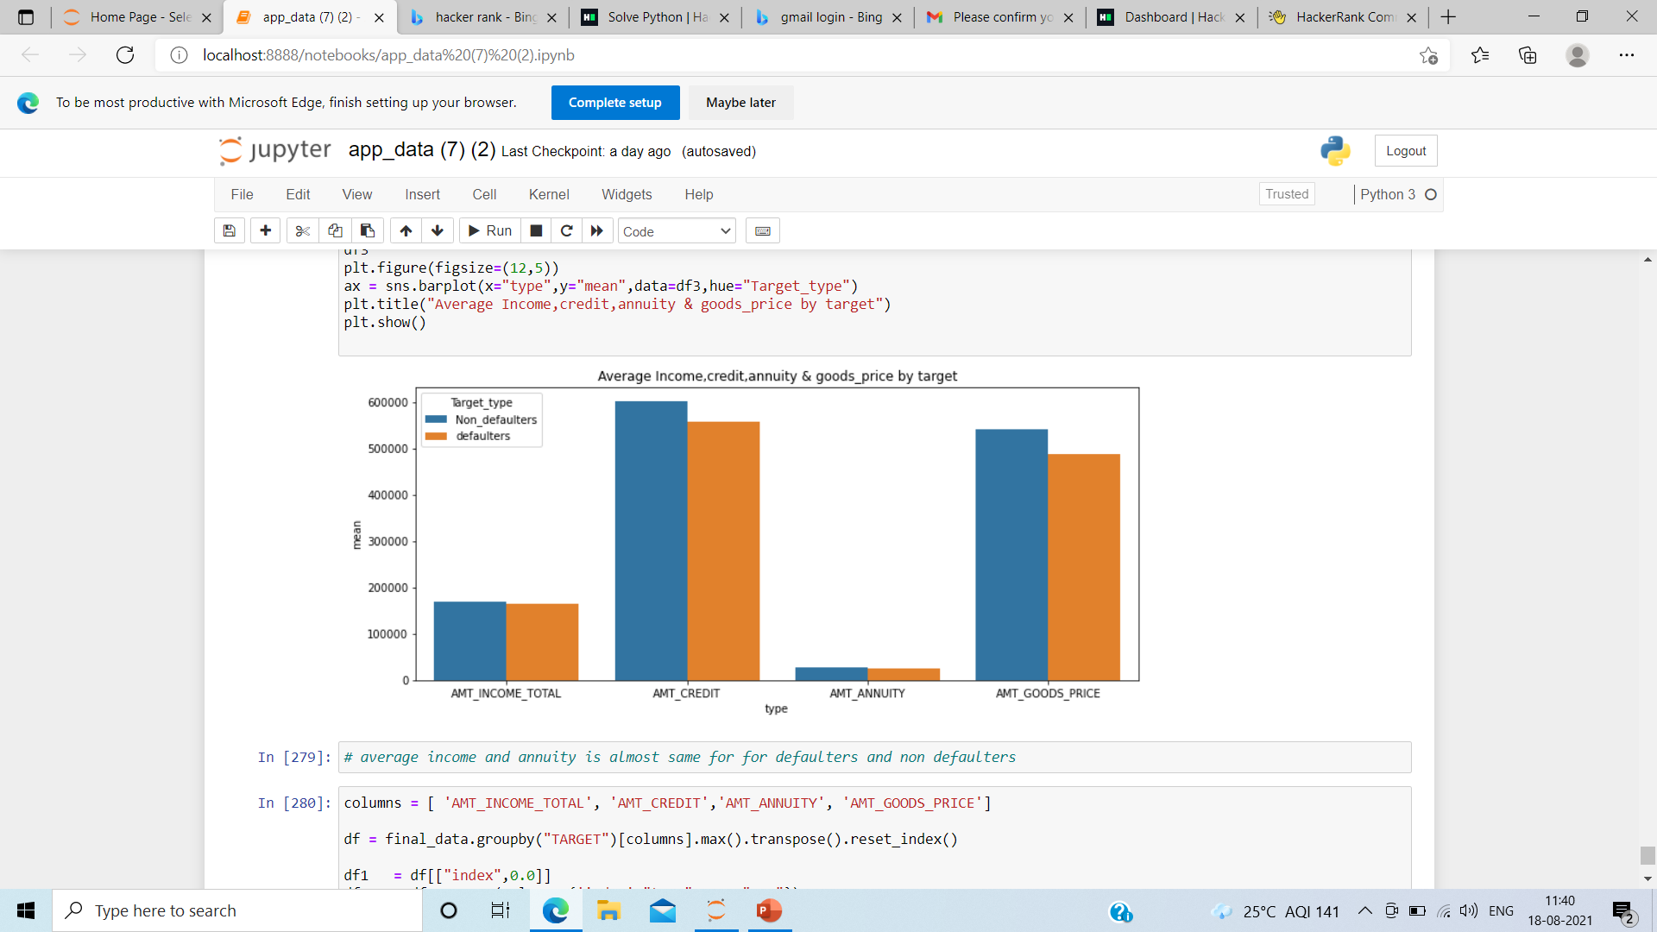
Defaulters are among those who has maximum income
average income and annuity is almost same for defaulters and non defaulters

Slide 12
CONCLUSION
Only 8% of the clients are defaulters
Out of these 8% defaulters most of them are female clients
66% of the clients don’t have car and among 66% female clients don’t have car
Married clients are more defaulters.
Most of the defaulters have less than higher education
Defaulters are among those who has maximum income

